Slide 1

Bharati Vidyapeeth’s College of Engineering Lavale, Pune
Department of Computer Engineering
Subject : Audit Course Class : BE
Topic Name : Programming In Java Roll No : 01
Presented By : Roshan Ramdas kate

Slide 2



Programming in Java: A Comprehensive Audit Course

Slide 3
Week 1: Introduction to Java
History and importance of Java
Setting up the Java Development Environment
Your first Java program
Understanding variables, data types, and operators
Input and output handling

Slide 4
Week 2: Control Structures
Conditional statements (if, else if, switch)
Looping (for, while, do-while)
Boolean expressions in decision-making
Breaking and continuing within control structures
Practice coding exercises

Slide 5
Week 3: Functions and Methods
Understanding the distinction between functions and methods
Declaring and invoking methods
Method parameters and return types
Exploring method overloading and recursion
Writing clean and reusable code using methods

Slide 6
Week 4: Object-Oriented Programming (OOP)
Introduction to OOP concepts
Working with classes and objects
Understanding constructors and destructors
Exploring encapsulation, inheritance, and polymorphism
Understanding abstraction and interfaces
Creating practical applications using OOP concepts

Slide 7
Week 5: Exception Handling
Understanding exceptions and their importance
Implementing try-catch blocks for error handling
Creating custom exceptions
Graceful handling of exceptions
Best practices for robust exception handling

Slide 8
Week 6: Collections and Data Structures
Working with arrays, ArrayLists, and other collections
Iterating through collections effectively
Exploring maps and sets
Understanding the power of generics
Applying collections in practical scenarios

Slide 9
Week 7: File Handling and I/O
Reading from and writing to files
Serialization and deserialization
Working with both text and binary files
Exception handling in file operations
Building practical applications involving file handling

Slide 10
Week 8: Advanced Topics
Multithreading and Concurrency
Networking in Java
GUI Programming (Swing, JavaFX)
Introduction to Java frameworks (Spring, Hibernate)
Best practices in Java development
Final project or assessment

Slide 11
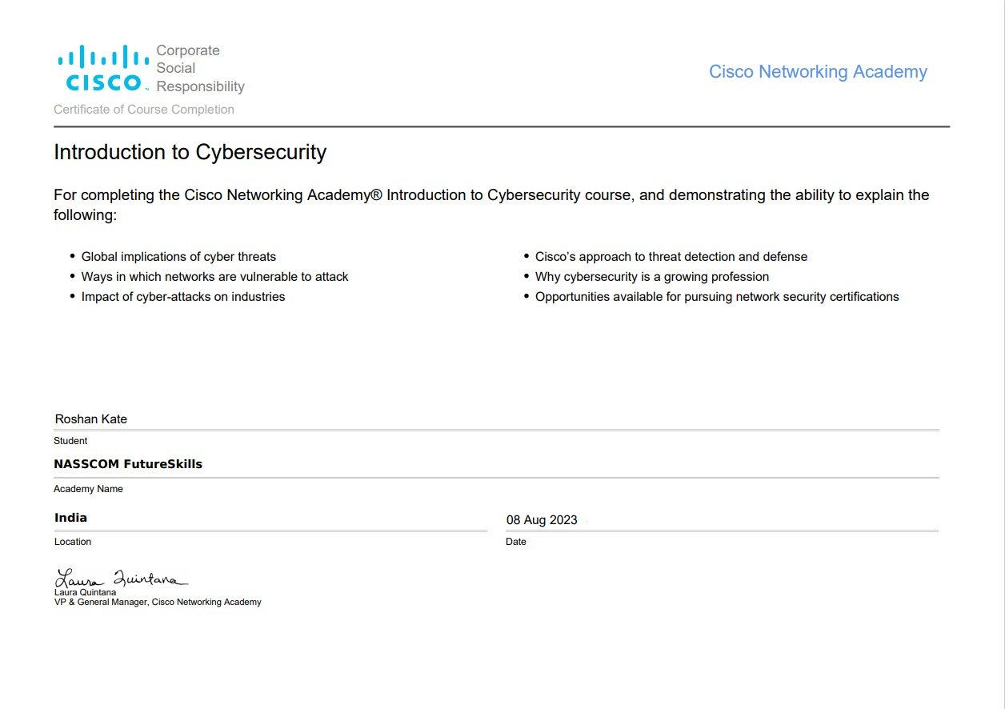

Slide 12


Slide 13
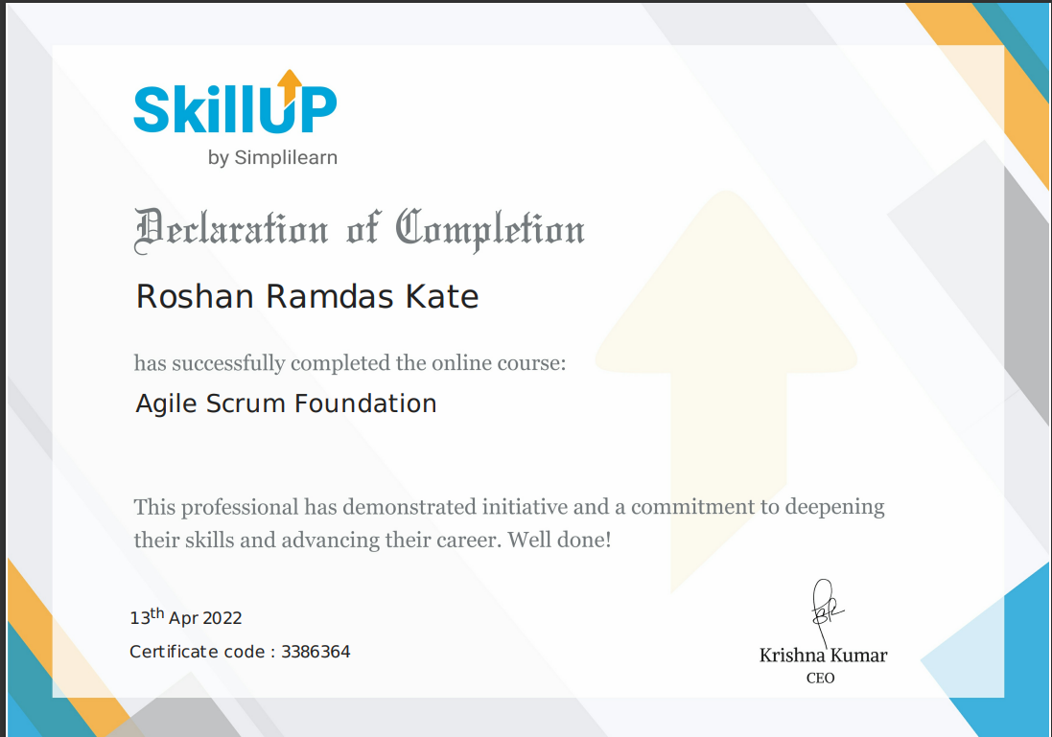

Slide 14
Conclusion
Throughout the course, encourage students to work on hands-on coding exercises and projects to reinforce their learning.
Additionally, provide resources for further self-study and exploration, as programming is best learned through practice and experimentation. You can also cover Java best practices, debugging techniques, and code version control tools such as Git.

